Slide 1
Economics 144 Economic Forecasting
Lecture 3
Modeling and Forecasting Trend
(Part I)
Dr. Randall R. Rojas

Slide 2
Today’s Class
Loss Function
Modeling Trend
Linear
Quadratic
Log-linear
Exponential
Model Selection
R Demo

Slide 3
Loss Function _{1 of 4}
Good forecasts lead to good decisions!
→ Strong link between forecasts and decisions.
Example: You started a firm and need to decide (now) how much inventory to hold going into the next sales period.
Strategy
Demand is high → build inventory
Demand is low → reduce inventory

Slide 4
Loss Function _{2 of 4}
 | Demand High | Demand Low
Build Inventory
Reduce Inventory
Loss
0
$10,000
$10,000
0
Symmetric Loss Structure: Both bad outcomes have the same loss.
 | Demand High | Demand Low
Build Inventory
Reduce Inventory
Loss
0
$10,000
$20,000
0
Asymmetric Loss Structure: Outcomes have different losses.
Notes:
The diagonal is zero since you make the correct decision to build during high demand and reduce during low demand. But if we make the wrong decision, there is a cost to that.

Slide 5
Loss Function _{3 of 4}
For every decision-making problem, there is an associated loss structure; for each decision/outcome pair, there is an associated loss.
0 → Correct Decision
>0 → Incorrect Decision
Loss
We could also forecast the sales!
 | High Actual Sales | Low Actual Sales
High Forecasted Sales
Low Forecasted Sales
Loss
0
$10,000
$10,000
0
Forecasting with Symmetric Loss: Both bad forecasts have the same loss.

Slide 6
Loss Function _{4 of 4}
Forecast Error (e): Difference between the realization (y) and the previously made forecast(ŷ) → e = y - ŷ
Loss Function (L(e)): Loss associated with a forecast. Must satisfy: (1) L(0)=0,(2) L(e) is continuous, and (3) L(e) is increasing on each side of the origin.
Examples of
loss functions:
Absolute Loss Function
L(e) =|e|
Quadratic Loss Function
L(e) =e²
Loss
Loss
Error
Error
Notes:
The further away the predicted value is from the true value, the greater the error and thus the greater the loss.

Slide 7
Modeling Trend
Trend: Is slow , long-run evolution in the variables that we want to model and forecast.
Deterministic Trend: Trend evolves in a perfectly predictable way.
To characterize a particular trend, we need a model. For example, in the case of linear regression, the model is: y_{t} = β₀ + β₁ x _{t}
Often, given the broad range of time scales encountered in time-series, it is convenient to adopt one common time variable (time dummy or time trend) such that: TIME* = (1, 2,…,T) where TIME=1 is the first period of the sample, and so on.
*The notation convention is TIME_{t} = t.

Slide 8
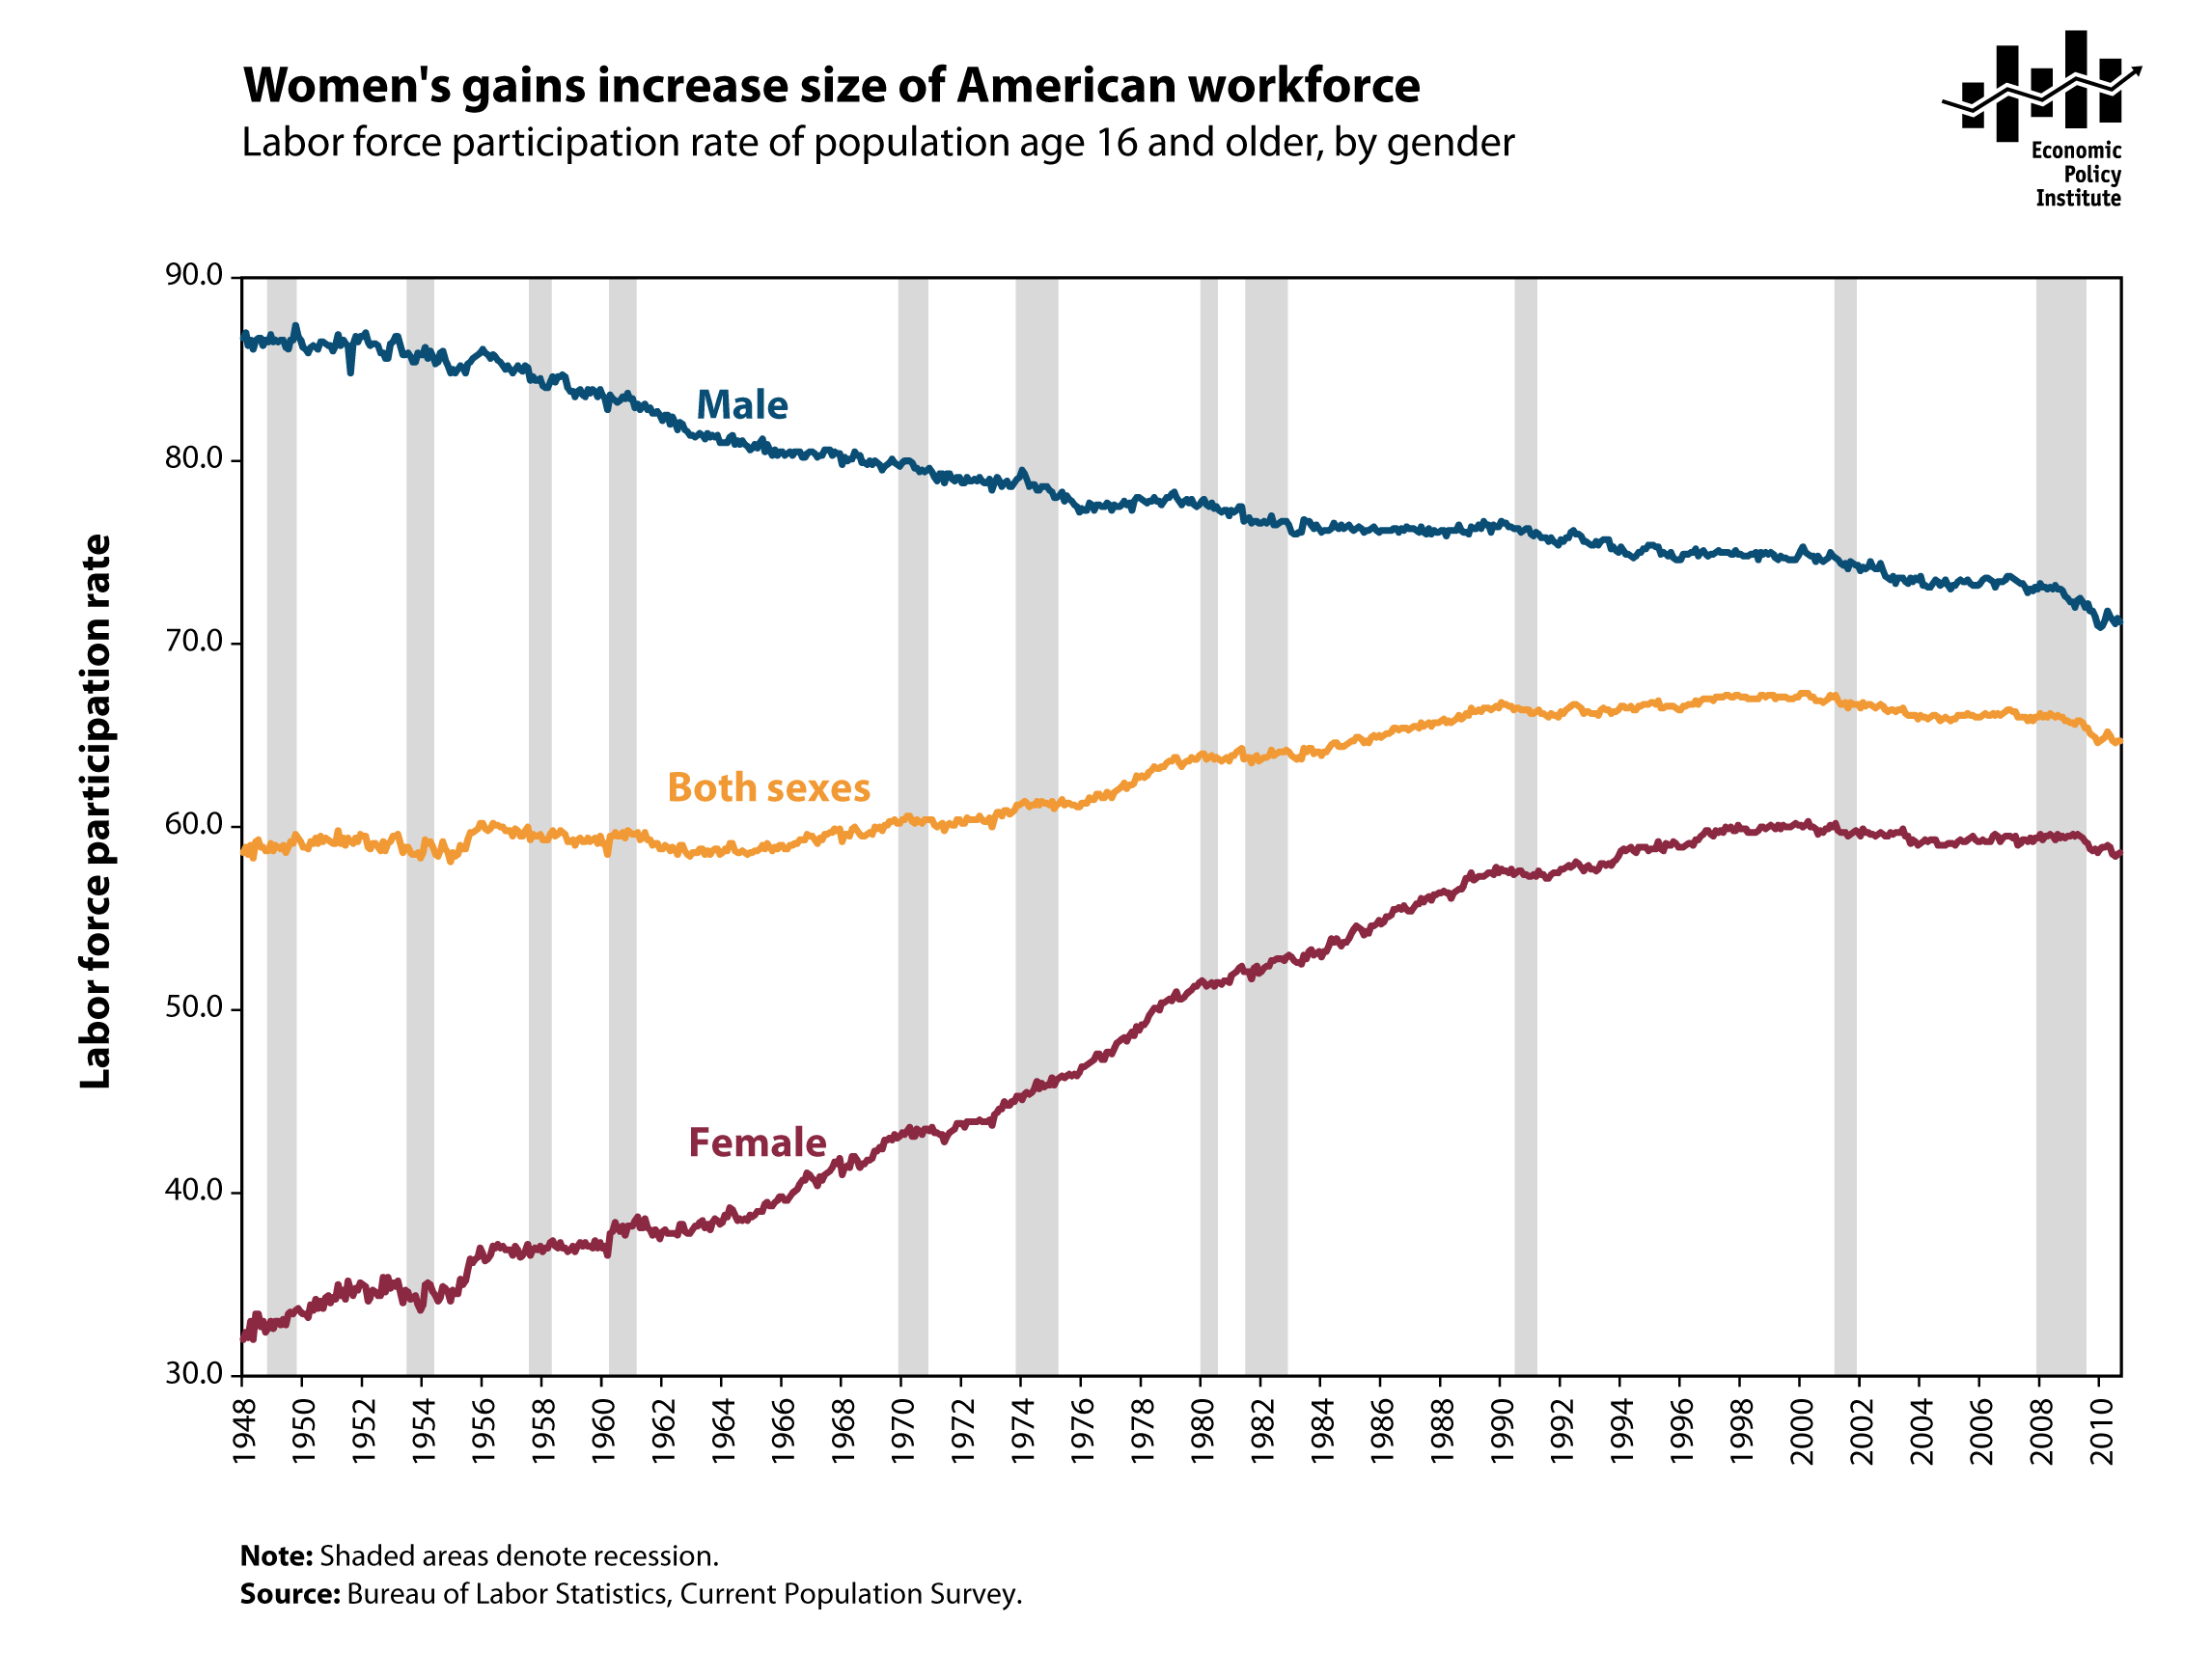
Modeling Trend (Linear) _{1 of 4}
http://stateofworkingamerica.org/charts/labor-force-participation-rate-of-population-age-16-and-older-by-gender/
Decreasing
Increasing
Model: T_{t} = β₀ + β₁ TIME _{t}

Slide 9
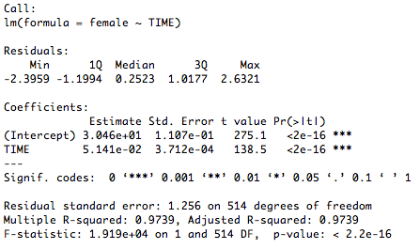
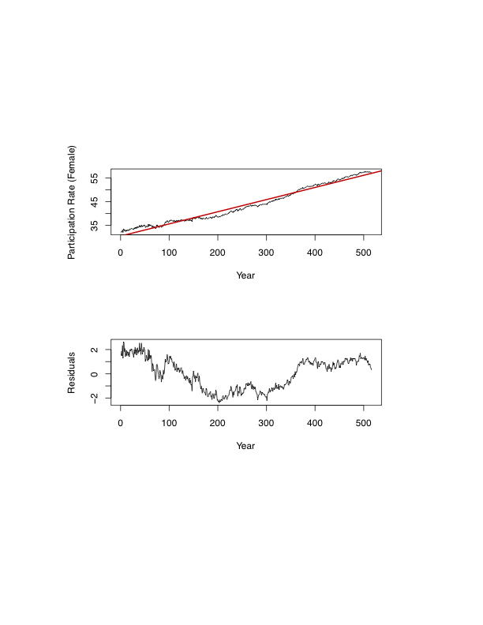
Modeling Trend (Linear) _{2 of 4}
Female Data
Fitted
Actual
R² =0.97→Excellent!
Do you see anything wrong?
Time : 1948-1990
Notes:
The model is bad since there is a cycle pattern in the plot of residuals over the years.
The other thing is to convert the x-axis back to the original years instead of the time stamp

Slide 10
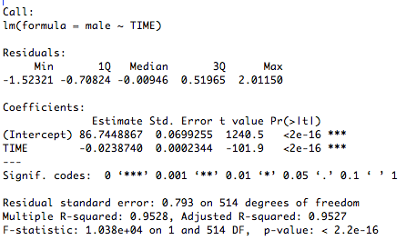
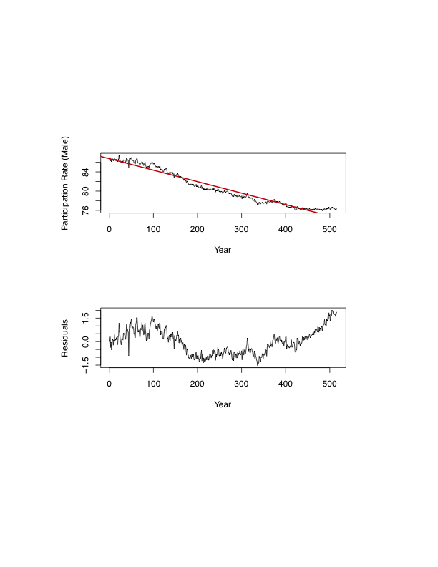
Modeling Trend (Linear) _{3 of 4}
Male Data
Fitted
Actual
R² =0.95→Excellent!
Do you see anything wrong?
Time : 1948-1990

Slide 11
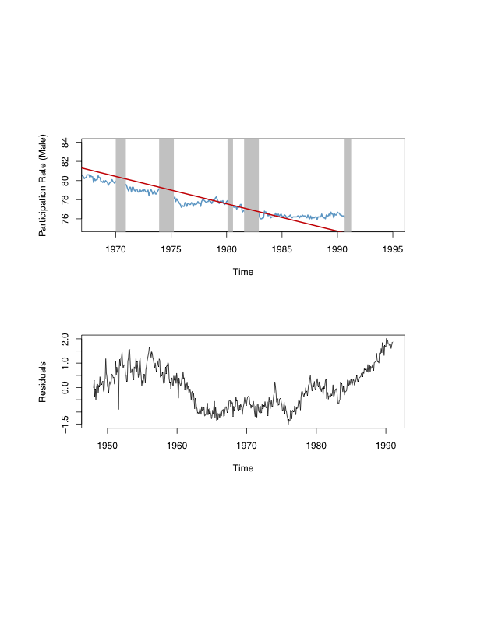
Modeling Trend (Linear) _{4 of 4}
U.S. Recession
Bands
Model: T_{t} = β₀ + β₁ TIME _{t}

Slide 12
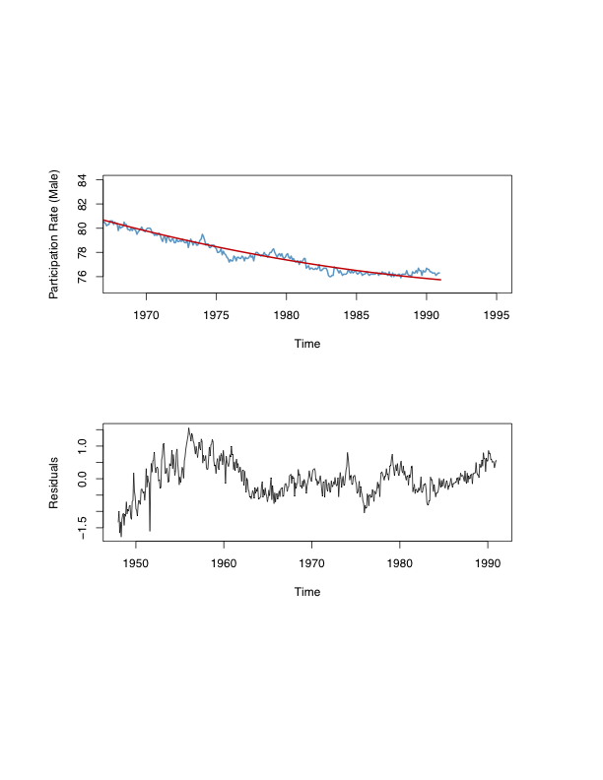
Modeling Trend (Quadratic)
Model: T_{t} = β₀ + β₁ TIME _{t} +β₂ TIME²
Notes:
The cycle pattern is less prominent here

Slide 13
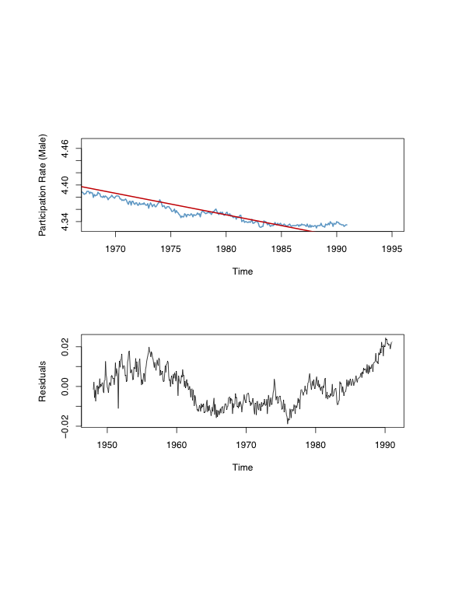
Modeling Trend (Log-Linear)
Model: log(T_{t}) = β₀ + β₁ TIME _{t}
Notes:
The fit is worse

Slide 14

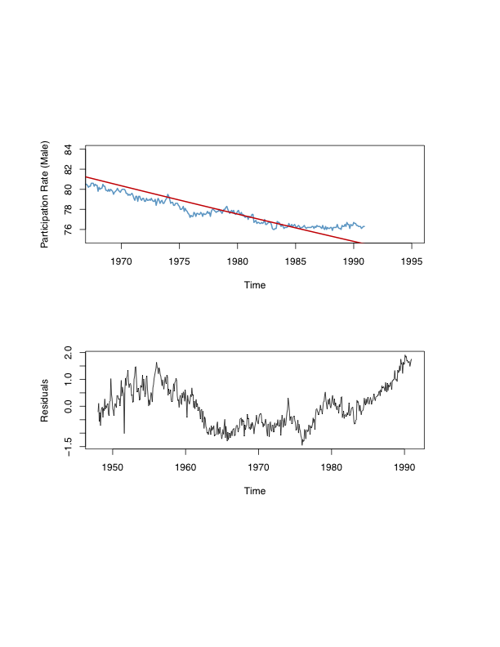
Modeling Trend (Exponential)
Model:
Notes:
The fit is bad

Slide 15
Model Selection via AIC and BIC
Model | df | AIC | BIC
Linear | 3 | 1229.0482 | 1241.7865
Quadratic | 4 | 808.3932 | 825.3776
Log-Linear | 3 | -3361.0625 | -3348.3242
Exponential | 3 | 1160.3758 | 1173.1141
The smaller the AIC/BIC value, the better the model.
Both AIC and BIC select the quadratic fit as the preferred model.

Slide 16



Forecasting Trend _{1 of 2}
Example (Point Forecast): Initially at T, and want to use a trend model to forecast the h-step-ahead value.
Assume a linear trend:
At time T+h:
Point forecast:
However, β₀ and β₁ are unknown. Solution: replace them with their LS estimates and .
Point Forecast:
~ 0 (zero-mean random noise)
Forecast is for t = T+h but based on t =T
Notes:
Note: the prediction interval is larger than the confidence interval since there is added uncertainty that we have not observed the value yet
You can choose to forecast by taking the time at T or time at T+1

Slide 17




Forecasting Trend _{2 of 2}
Example (Interval Forecast): Same idea as before. Assume the trend regression disturbance is normally distributed, then:
Interval Forecast:
In practice, use:
Example (Density Forecast): Same idea, yet again!
Density Forecast:
In practice, use:

Slide 18
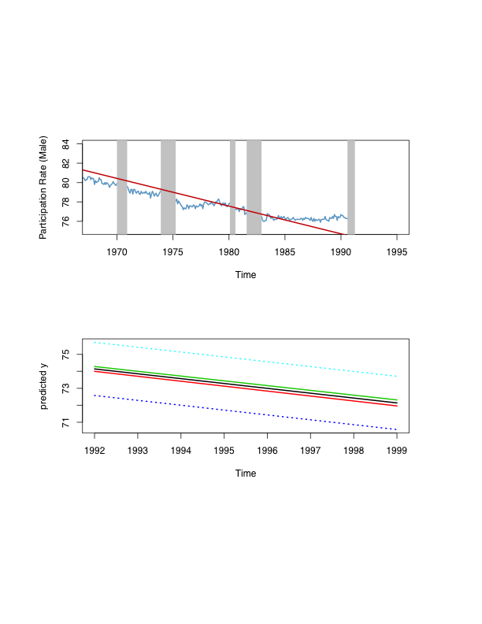
Forecasting Trend (Example)
95% Confidence Interval 95% Prediction Interval
Notes:
Prediction interval is larger than the confidence interval since you have to consider the uncertainty that you do not have data after 1991

Slide 19
For Next Class
Readings about today’s class:
Chapter 5^{b}
Review Exercises / Problems:
Chapter 3^{b}: 1, 2, 3, 5
Chapter 4^{b}: 4, 5, 9
Chapter 5^{b}: 1, 6
Readings for next class:
Chapter 5^{b}: Forecasting Retail Sales

